Slide 1

BOARD PRESENTATION
January 2026
Road Safety
Analytics
Data-Driven Accident Risk Prediction

Slide 2
Impact Metrics
150-250
7-15x
8-18
Lives Saved
Return on
Month
Annually
Investment
Payback Period
If we implement Phase 1 over next 6 months...

Slide 3
Problem Statement
What's wrong TODAY — and how we fix it
CURRENT STATE
FUTURE STATE
Reactive
Proactive
Emergency response AFTER accidents
→
Prevention BEFORE accidents happen
→
Uniform Resources
Targeted Investment
Spreading budget evenly across network
Focus resources on highest-risk areas
→
Calendar-Based
Data-Driven Decisions
Holiday/school seasonal programs without data
Evidence-based interventions that work

Slide 4
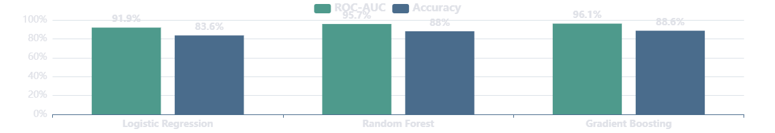
Built Confidence Through Multiple Models
All three models agree on top risk factors
✓ RECOMMENDED
Logistic Regression
Random Forest
Gradient Boosting
ROC-AUC
91.9%
ROC-AUC
95.7%
ROC-AUC
96.1%
Accuracy
83.6%
Accuracy
88.0%
Accuracy
88.6%
Model Performance Comparison

Slide 5
Three Factors Explain 90% of Accident Risk
Lighting
Speed
Curvature
Night vs Day
High vs Low Speed
Curved vs Straight Roads
62%
66%
48%
Increased Risk
Increased Risk
Increased Risk
Poor lighting conditions significantly increase accident probability
Higher speeds dramatically reduce reaction time and increase impact severity
Road curvature requires enhanced driver attention and vehicle control

Slide 6
The Danger Zone: Where Accidents Cluster
SCENARIO A
SCENARIO B
Safest Conditions
Most Dangerous
Low Speed
4.38x
High Speed
Straight Road
Curved Road
Daylight
MORE DANGEROUS
Night
Risk Level
Risk Level
16%
71%
This combination accounts for majority of accidents

Slide 7
Surprising Findings: Where NOT to Invest Resources
Expected vs Reality — Resources we can STOP wasting
Holidays
We assumed:
Reality:
Holidays cause more accidents
No measurable effect
(0.1% difference)
School Seasons
We assumed:
Reality:
School seasons increase accidents
No measurable effect
(0.15% difference)
Road Signs
We assumed:
Reality:
Signs reduce accidents
No protective effect
(0.2% difference)
Stop wasting resources on ineffective interventions

Slide 8
Phase 1: 6-Month Quick Wins
Month 1
Month 2
Month 3
Month 4
Month 5
Month 6
Procurement & Planning
Month 1-2 • Milestone: Contractor selection
Engineering & Permitting
Month 2-3 • Milestone: Approvals
Installation & Deployment
Month 3-6 • Three Parallel Interventions
Lighting Deployment
Speed Management
Visibility Enhancement
$2-3M
$1.5-2M
$0.5-1M

Slide 9
Investment Pays Off in Months
INVESTMENT
ANNUAL RETURNS
$5M
Payback Timeline
(Year 3+)
8-18
$45-70M
One-time Phase 1
Months
Strategic infrastructure improvements
Continuous annual savings
Healthcare Savings
Productivity Gains
Insurance Savings
Annual Return
$15-25M
$20-30M
$10-15M
7-15x

Slide 10
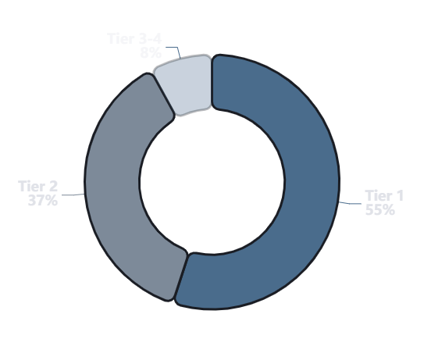
Strategic Resource Deployment
70% of budget on 25% of network
Budget Allocation Strategy
1
Tier 1
Highest Impact
Network Coverage
Budget Allocation
5-10%
50-60%
Concentrated on most dangerous roads — highest accident prevention per dollar
2
Tier 2
Strong Impact
Network Coverage
Budget Allocation
20-30%
35-40%
Secondary priority areas with measurable risk factors
3-4
Tier 3-4
Maintenance
Network Coverage
Budget Allocation
50-70%
5-10%
Low-risk areas requiring minimal intervention
Prevents disproportionate number of accidents through intelligent targeting

Slide 11
Board Decision: Three Approvals Needed
1
2
3
Approve Phase 1 Funding
Establish Governance
Conditional Phase 2 Auth
Investment
$4.5-6.5M
Executive Steering Committee
If Phase 1 Validates
Strategic oversight and decision-making
Automatic progression upon success
Timeline
Technical Execution Team
Contingent Approval
6 Months
Day-to-day implementation management
Pre-approved pathway to expansion
Expected Impact
Quarterly Reporting
Maintains Momentum
25-35%
Progress and performance metrics
No delays between phases
Accident Reduction
APPROVE
APPROVE
APPROVE

Slide 12

The Real Impact: Lives Saved
1,500 - 4,000
Lives Saved
Over 10 Years
150-250
250-400
Lives Saved Annually
Lives Saved Annually
Phase 1-2 Implementation
Full Program Deployment
That's families staying intact.
Communities remaining whole.

Slide 13
From Data to Decision
Which roads are most dangerous?
Why are they dangerous?
We know. (96% accuracy)
We know. (Lighting, speed, curvature)
What interventions work?
What's the ROI?
We know. (Proven infrastructure)
We know. (7-15x annually)
The only question is:
Will we act on this evidence?

Slide 14

Questions?
We've included detailed analysis in the executive report
Quarterly metrics dashboard available upon approval

